Slide 1
Knowledge Based Lightmap Improvement for Closed Enviourment
Intern Name : Ketan Gupta
Mentor Name : Gyanendu Shekhar
Team/Group/Part : Immersive XR Team/XR Platform Team / XR Composition and Rendering
College / Branch : IIT Kharagpur / CSE

Slide 2
Problem Statement
To store the lighting information and apply it on the virtual object and render the scene

Slide 3
Tools Used
Google AR Core: Provides various API’s for capturing information about a scene
MongoDB database: To store information about lighting
OpenGl : A C++ API to render the scene along with virtual object and apply lighting
Android Studio: IDE to create app

Slide 4
Procedure
Use Google ArCore to get lighting information of every voxel in the frame
Find Geospatial coordinates of the voxels and use them to store lighting
information
For the first frame store the lighting information for all the voxels
For the next iteration update only the changed voxels and store them
Load the model of the object into the scene and anchor it
Apply the lighting into the model

Slide 5
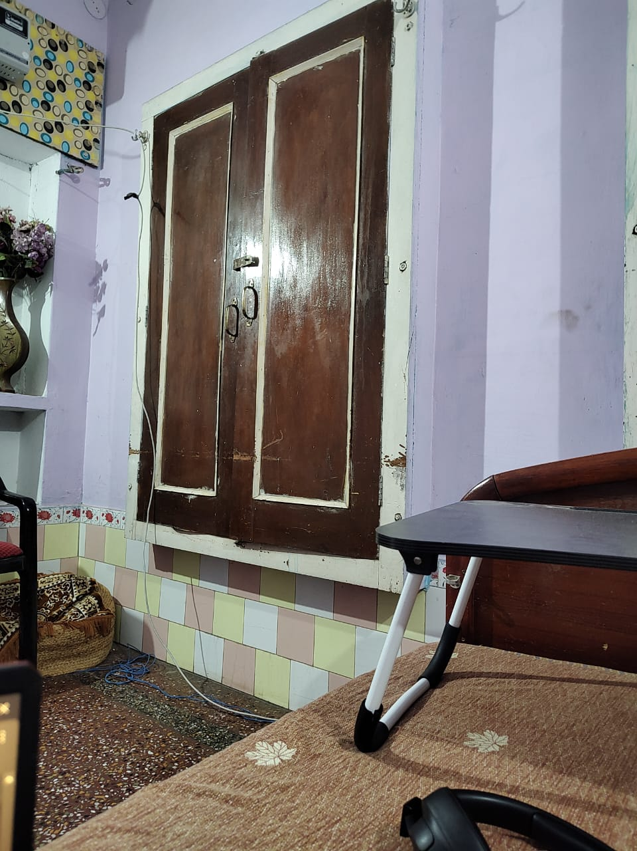
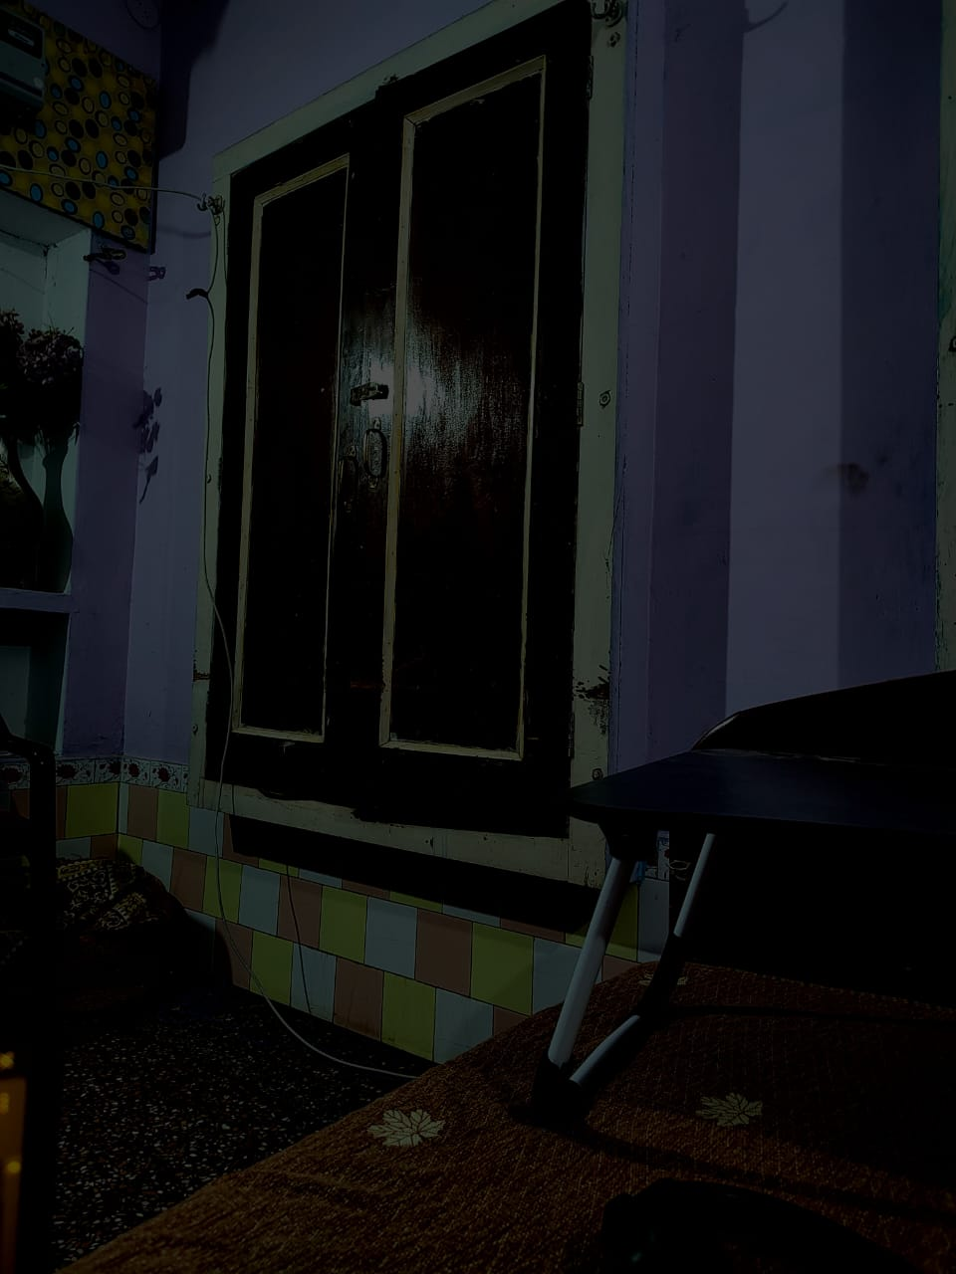
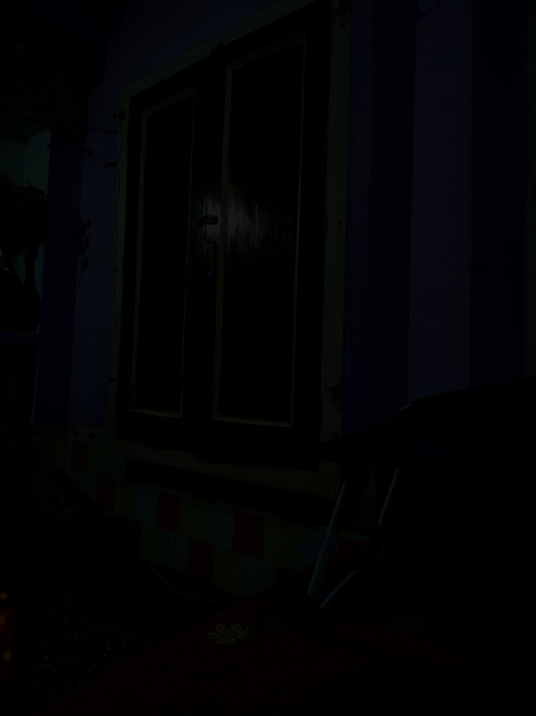
Test Results (Storing Light)
Initial frame After 3 frames After 6 frames
Here I switch off the light to show that the light info is stored

Slide 6
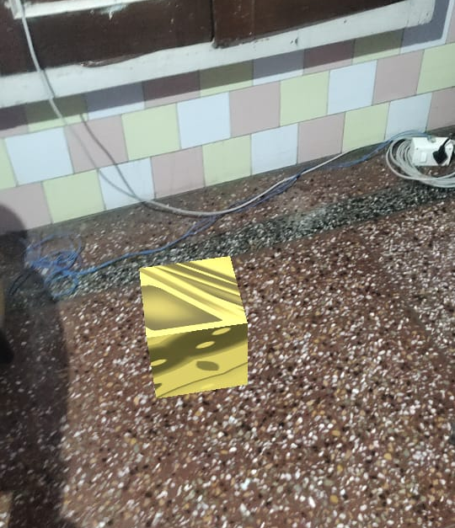
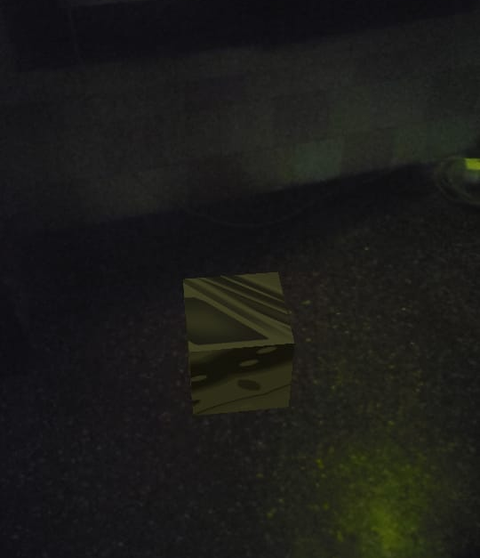
Test Results (Applying Model)

Slide 7
Further improvements
Optimize process to identify changed voxels to capture the the lighting faster
Improvise lighting on virtual object
Improvise implementation of lighting to render the scene after integrating the virtual object

Slide 8
Thank You

